Slide 1
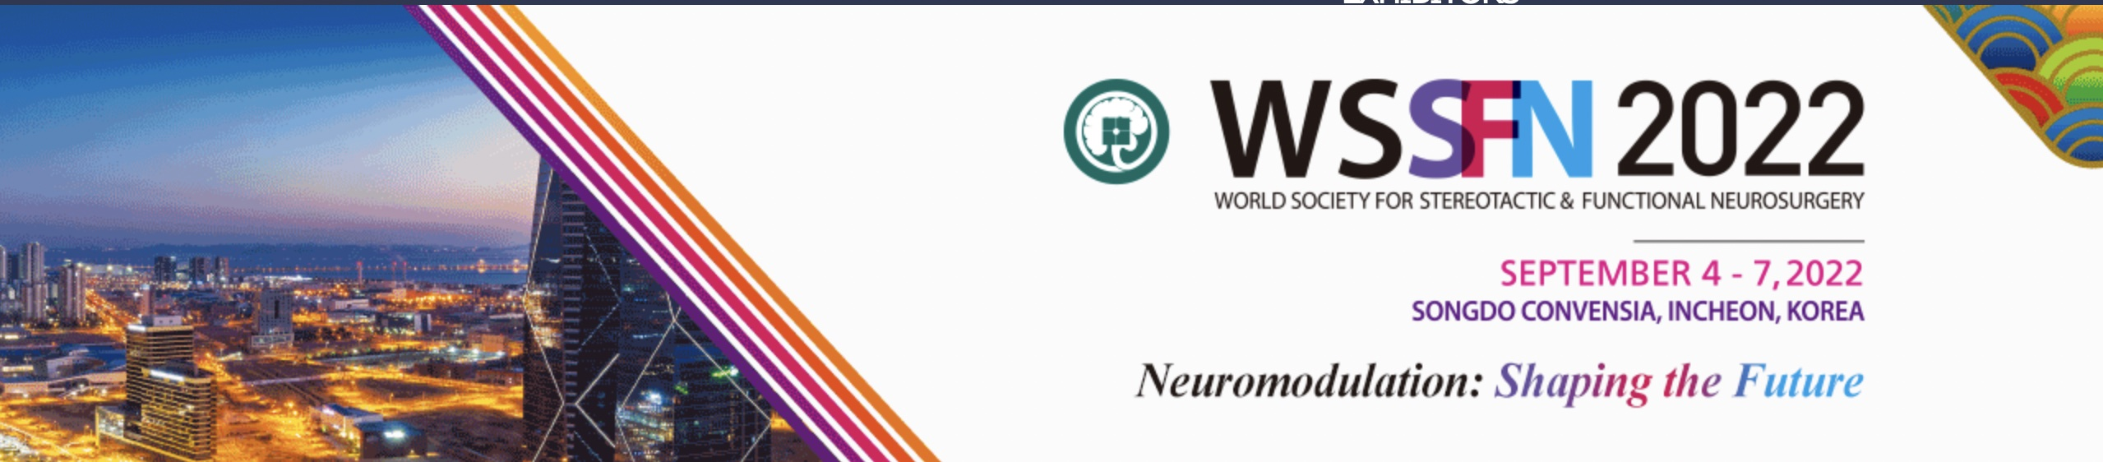

WSSFN 2022
Awards Ceremony

Slide 2
Scientific submissions
Total number of oral presentations: 45
Total number of flash presentations: 108
Total number of poster presentations: >200

Slide 3
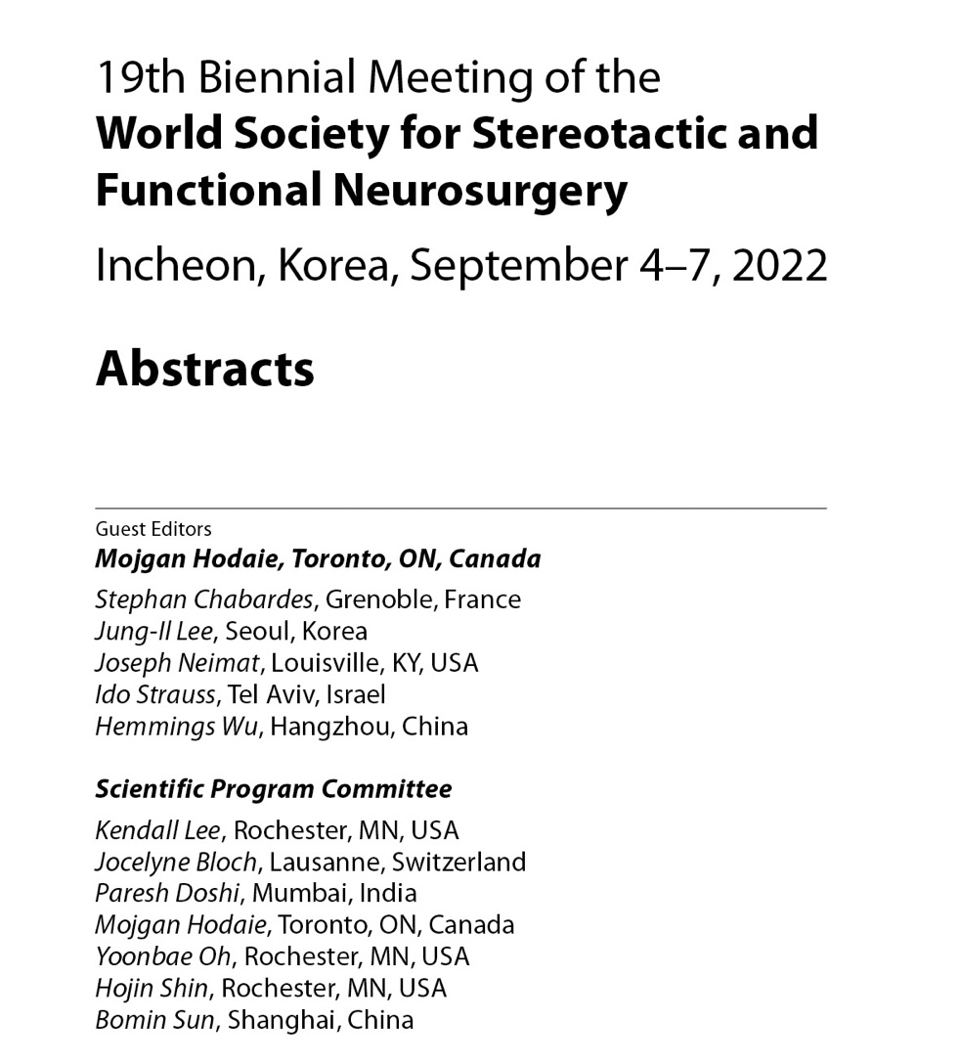

Now Online!

Slide 4
WSSFN Travel Grants
Nepal
Russian Federation
India
Canada
Japan
United Kingdom
USA
Turkey
Japan
Croatia
Spain
Uzbekistan
Indonesia
Italy
Poland
Trinidad & Tobago
Estonia
Turkey
Egypt
China
Since 2013
Encourage residents and fellows across the globe to attend the WSSFN meeting
Record number of submissions for WSSFN2022!

Slide 5
Thank you to our judges!
Oral presentations:
Poster Presentations:
Patric Blomstedt – Sweden
Marie Krueger – UK
Hiroki Toda – Japan
Nico Enslin – South Africa
Olga Parras – Spain/UK
Can Sarica – Canada/Turkey

Slide 6
Best Oral Presentation – Clinical
Evolution Of Targeting Of The Anterior Limb Of The Internal Capsule Circuits For Obsessive Compulsive Disorder: Multi-institutional Experience
Josue Avecillas Chasin, Kisueng Choi, Andrew Smith, Helen Mayberg, Brian Kopell, Martijn Figee
USA

Slide 7
Best oral presentation – Basic Science
Unbiased Whole Brain Circuit Examination Reveals Novel Neurons That Restore Locomotion After Spinal Cord Injury
Newton Cho, J. Squair, N. James, L. Baud, A. Leonhartsberger, K Sveistyte, K Galan, Q Barraud, M Goubran, L Batti, S Pages, M Gauthier, T Hutson, C Kathe, A Bichat, O Rizzo, M Hodara, J Bloch, G Courtine
Canada/Switzerland

Slide 8
Best Poster Presentation – Clinical
Effects Of Thalamic DBS For Tourette’s Syndrome in a Prospective Randomized Clinical Trial
Pablo Andrade, Juan Carlos Baldermann, Veerle Visser-Vandewalle
Germany

Slide 9
Best Poster Presentation – Basic Science
Enhanced Delivery Of Aducanam Via FUS Alleviates Cognitive Impairment In Neuropathology In Alzheimer’s Disease
Chanho Kong, Eun-Jeong Yang, Jaewoo Shin, Junwon Park, Won Seok Chang, Changhan Lee, Hyunju Kim, Hye-Sun Kim, Jin Woo Chang
Korea

Slide 10
Karger Award - Best Oral Presentation
Extensive Frontal Focused Ultrasound Mediated Blood-brain Barrier Opening for the Treatment of Alzheimer’s Disease
So Hee Park, Kyoungwon Bail, Seun Jeon, Won Seok Chang, Byong Seok Ye, Jin Woo Chang
Korea

Slide 11
Karger Award - Best Poster Presentation
Differences In STN Subregional Activity During Performance Of A Motor Conflict Task In Humans With Parkinson’s Disease
Travis Stewart, Jessica McDonnell, Joseph Neimat, Scott Wylie, Neileke Van Wouwe
USA

Slide 12
Karger Award - best oral presentation runner up
Sub-second Fluctuations Of Extracellular Dopamine And Serotonin Levels Encode Learning Signals That Influence Behavioral Control And Conscious Phenomena Experience In Humans
Kenneth Kishida, Adrian Laxton, Stephen Tatter
USA

Slide 13
Karger Award - Best Poster Presentation runner up
Prospective Randomized Clinical Study: Does TYRX Antibiotic Envelope For DBS IPG Replacement Affect IPG Infection Rate?
Terry Coyne, Michael Colditz, Tomas Heard, Peter Silburn.
Australia

Slide 14
Best Oral Presentation – Honorable Mention #1
7 Years Of 7-tesla In Deep Brain Stimulation For Parkinson’s Disease: Pinpointing The Dorsal STN
Maarten Bot, Neils Rijks, Lisa Verlaat, Naomi Kremer, Varvara Mathiopoulou, Francisca Ferreira, Mark Robers, Rob de Bie, Pepijn van den Munckhof, Rick Schuurman
Netherlands

Slide 15
Best Oral Presentation – Honorable Mention #2
Diffusion Tensor Imaging Evaluation Of Pateints With Disorders Of Consciousness Prior To Deep Brain Stimulation: A Preliminary Study
Marina Raguz, Darco Oreskovic, Andelo Kastelancic, Petar Marcinkovic, Marin Lakic, Fadi Almahariq, Dominik Romic, Domagoj Dlaka, Niko Radovic, Igor Fuckan, Vedran Deletis, Darko Chudy
Croatia

Slide 16
Best Poster Presentation – Honorable Mention #1
The Effect Of Pulsed RF Combined With A Transforaminal Epidural Steroid Injection On Chronic Lumbar Radiculopathy – Vietnam Prospective Study
Viet-Thang Le, Tuan An Pham
Vietnam

Slide 17
Best Poster Presentation – Honorable Mention #2
An Artificial Intelligence-driven System of Grading Trigeminal Neuralgia And Prediction of Surgical Outcome
Timur Latypov, Rose Yakubov, Peter Hung, Pascale Tsai, Matthew Walker, Wanzhang Wai, Marina Tawfik, Frank Rudzicz, Mojgan Hodaie
Canada

